Slide 1


Hotel And Resort Booking Report
Weekly And Yearly

Slide 2
What problem are we solving?
Analyze Hotel & resort booking performance.
01
Understand cancellation behavior.
02
Compare weekly and annual trends.
03

Slide 3
Dataset Overview
Data range
2015-2017
01
Total bookings
119,390
02
Total revenue
25.99 Million
03

Slide 4
Dataset Overview
Resort hotel
Bookings – 40,060
Cancellation – 11,122
02
City hotel
Bookings – 79,330
Cancellations – 33,102
01

Slide 5
Monthly Booking Trend
Highest Booking Month
AUGUST (13,877 BOOKINGS)
01
Peak Season
JuLY & auGUST
02
Lowest Booking
January & December
03

Slide 6
Monthly Cancellation Trend
JUNE
41.45%
01
APRIL
40.79%
02
May
39.66%
03

Slide 7
Insights
City Hotel get Higher Bookings
2
City Hotel Also have Higher Cancellation
3
Resort have more Stable Booking Behavior
1

Slide 8
Revenue Insights
Total Revenue (Non-cancelled only):
25.99 Million
Higher ADR Months (Summer)
Longer Stays
City Hotels contribute majority share

Slide 9
Top Countries
BOOKINGS
Portugal(PRT)
48,590
BOOKINGS
UK(GBR)
12,129
BOOKINGS
France(FRA)
10,415

Slide 10
Lead Time Analysis
High lead time bookings are more likely to cancel.
Longer advance bookings show higher uncertainty and cancellation probability.

Slide 11
Weekly Analysis Insights
Summer weeks (week 27–35) show peak bookings
Weekend stays increase ADR revenue
Business demand higher in city hotels on weekdays

Slide 12
Business Insights
37% cancellation rate is major revenue leakage.
City hotels generate higher revenue but face higher cancellation risk.
Summer months (July–August) drive peak demand.
Portugal contributes majority of bookings.
High lead-time bookings increase cancellation probability

Slide 13
Recommendation
Introduce partial prepayment for high lead-time bookings.
Apply dynamic pricing during summer.
Focus marketing on UK & France markets.
Offer incentives to reduce cancellations.
Improve forecasting using predictive modeling.

Slide 14
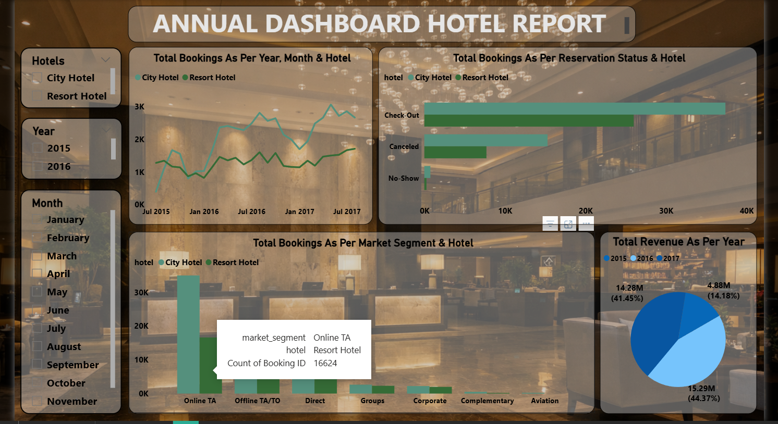
Annual Dashboard Hotel Booking

Slide 15
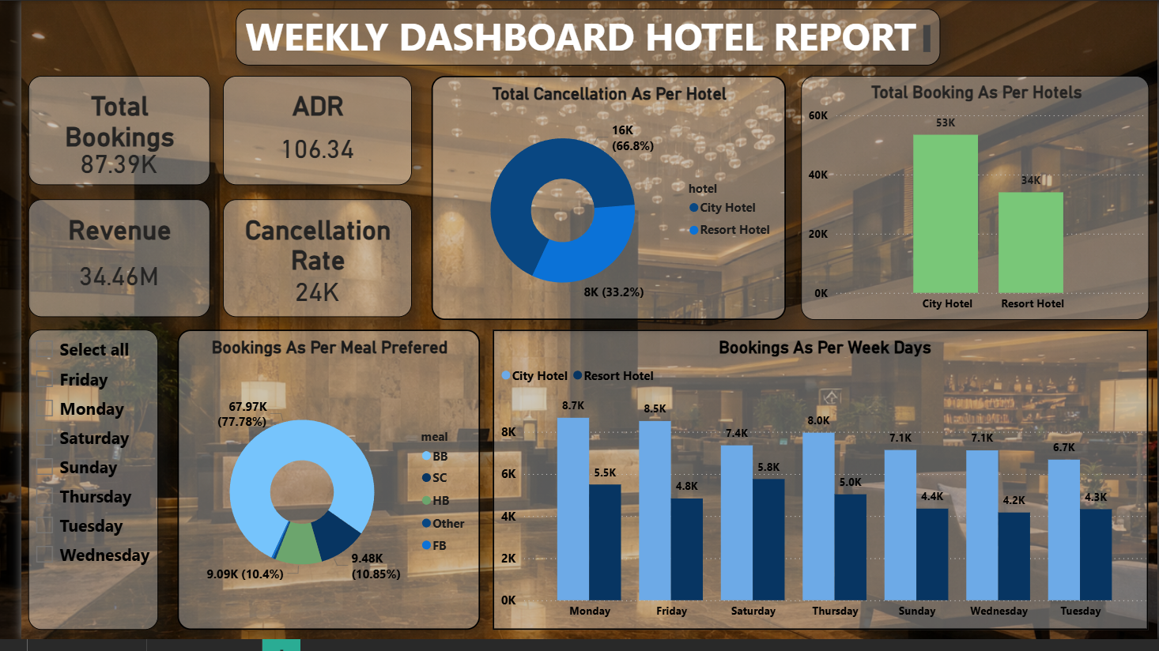
Weekly Dashboard Hotel Booking

